Slide 1
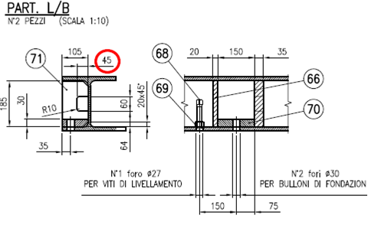
HS&E INCIDENT BULLETIN |  | 1st half year 2014
Location Country | Type of incident (example: Slip-Trip, Fall from Height, Vehicle , Laceration, Chemical Exposure)
Summary:
During unloading from vehicle of baseplate, the operator noted that the plates were under dimensioned, making impossible the insertion of eye bolts. The operations of slinging loads were more complicated than usual, prejudicing the safety of the operator assigned to the discharge
Root Causes: | Actions Taken Thus Far: Next Steps
Lack of training of technical staff Ineffective control of design | Ensure continuous training to personnel Issue dedicated check-list to facilitate controls by draftsman of details with potential impact on safety Evaluate new methods and/or equipment to facilitate the slinging of loads

